Slide 1
AWS RESOURCE CREATION USING ANSIBLE
Bhargavi Bairagoni

Slide 2
Agenda
Creating resources with ansible using
Inline variables.
Outline variables.
Without variables.

Slide 3
Ansible
Ansible is a open source automation platform that can be used to manage large groups of computer systems. It helps you automate application deployment, configuration management, cloud provisioning, updating work stations and servers and many other tasks.
Process Steps:
Prepare AWS account.
Install required software (Python, Boto3, etc.).
Setup local project directory with SSH keys.
Create and run Ansible playbooks.
Required Libraries:
Python, Pip, Boto/Boto3, Ansible.

Slide 4
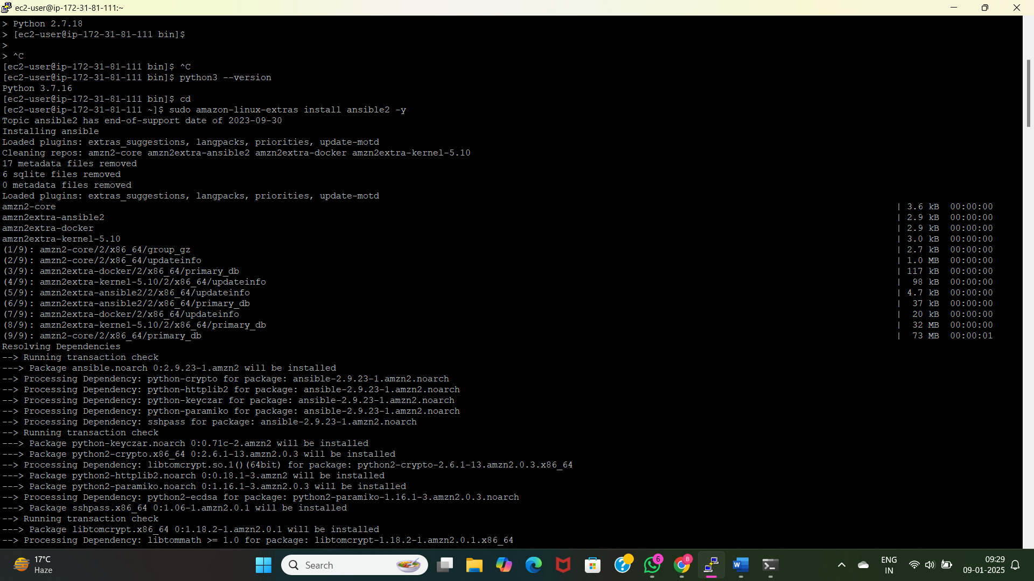
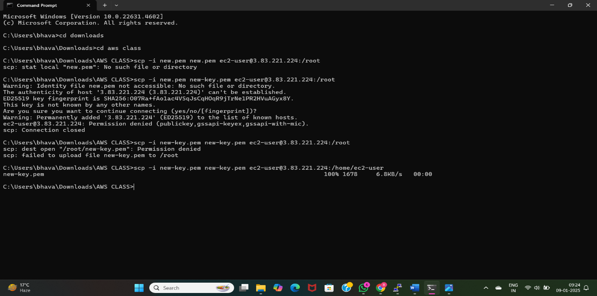
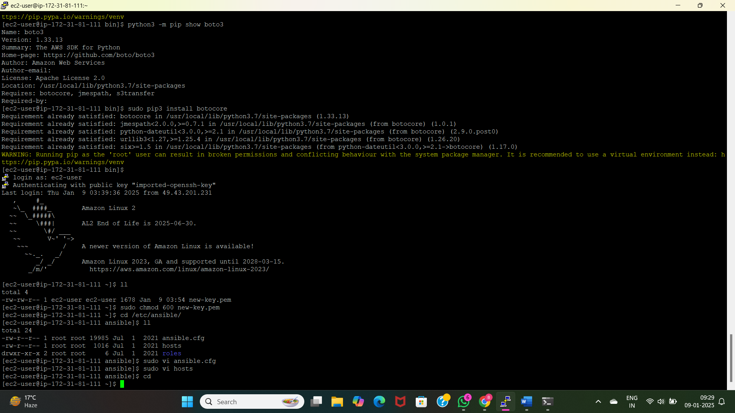
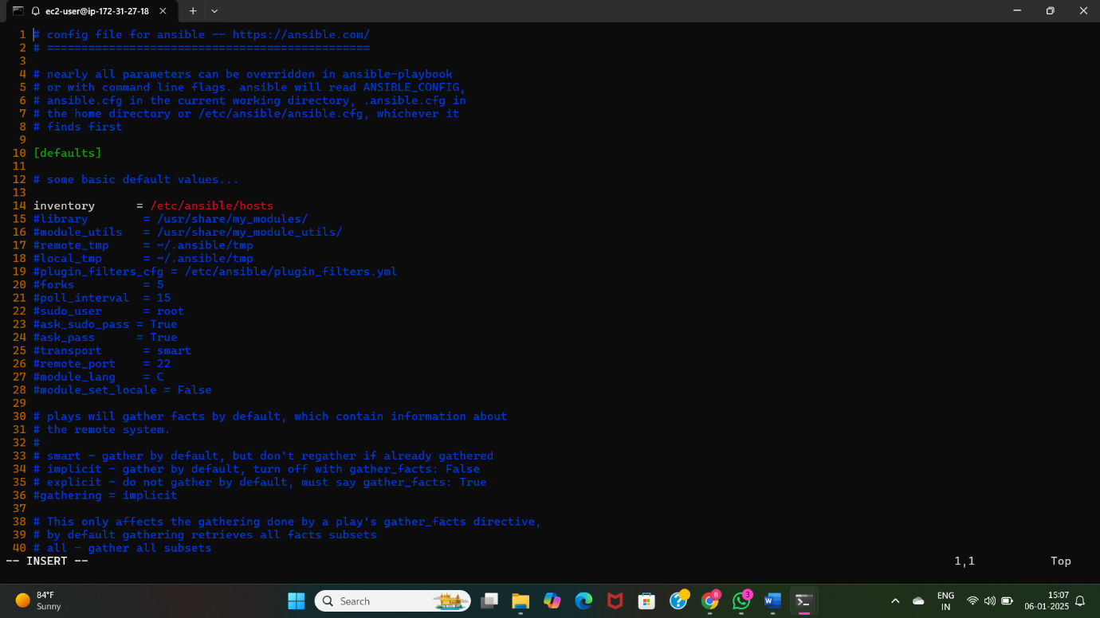

Slide 5
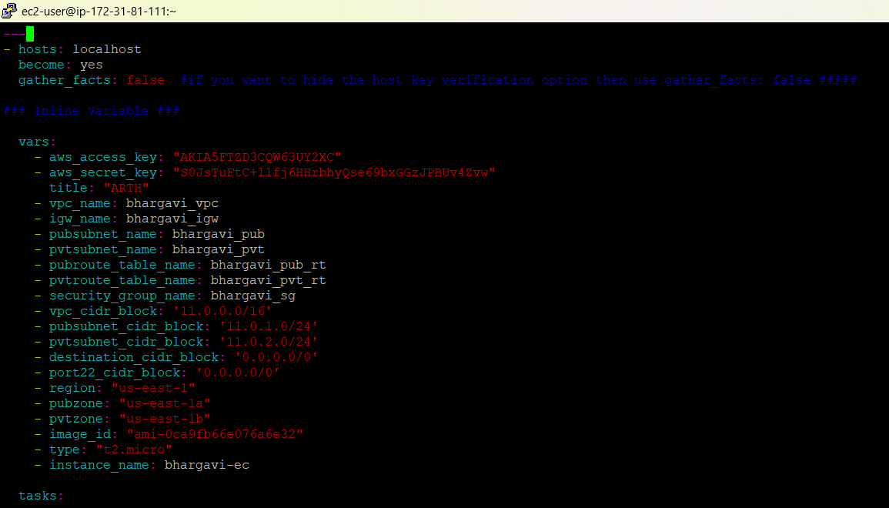
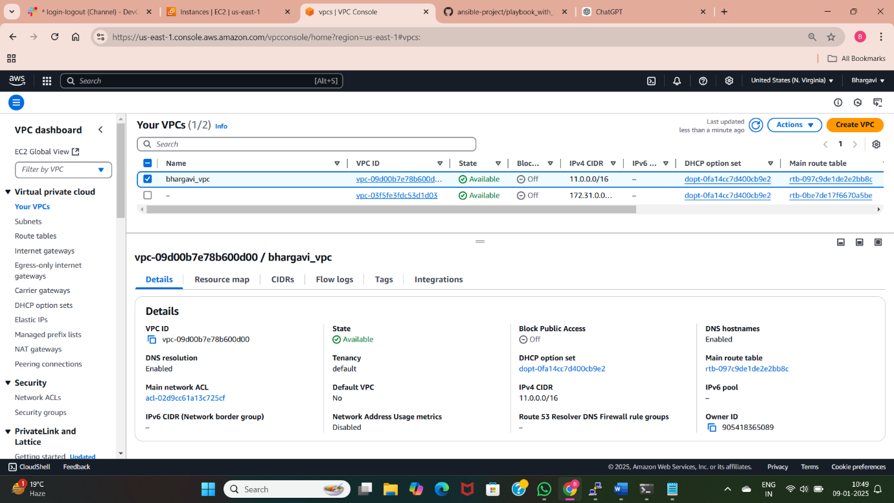
Inline Variable
An inline variable refers to defining a variable directly within a task, playbook, or module, rather than declaring it separately in a variable file or inventory.
Playbook name : vpc.yml
Commands to create playbook “ansible-playbook vpc.yml”

Slide 6
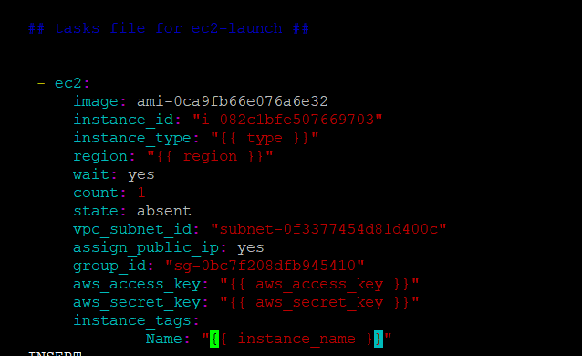
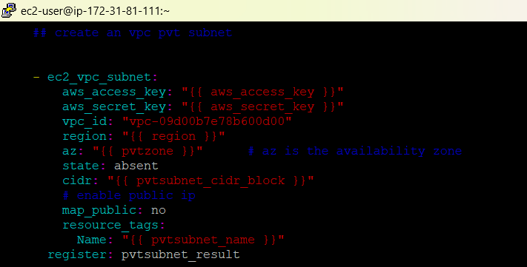
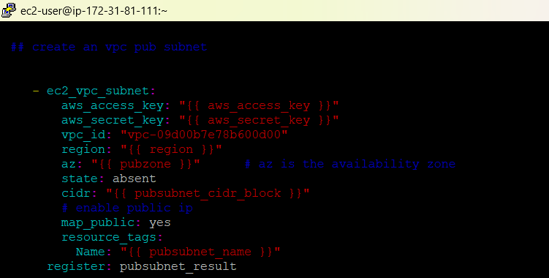
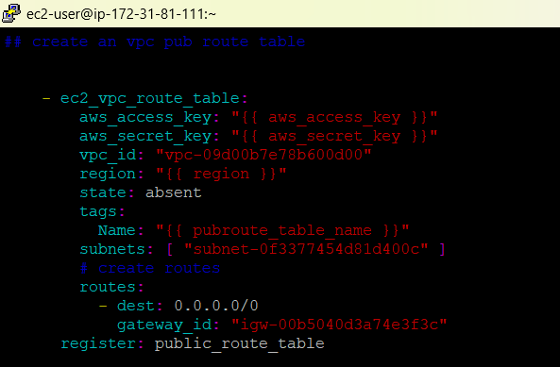
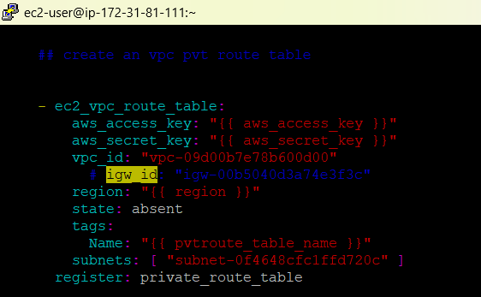

Slide 7
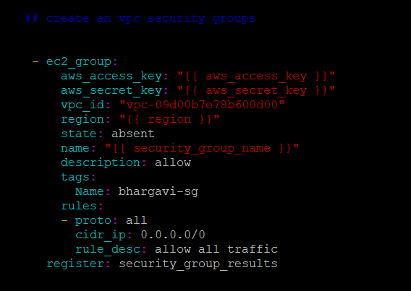
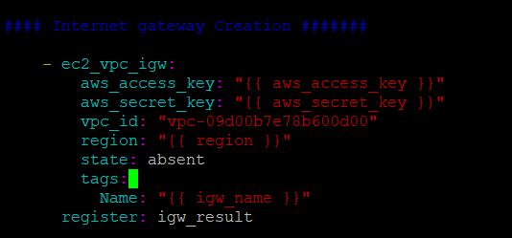
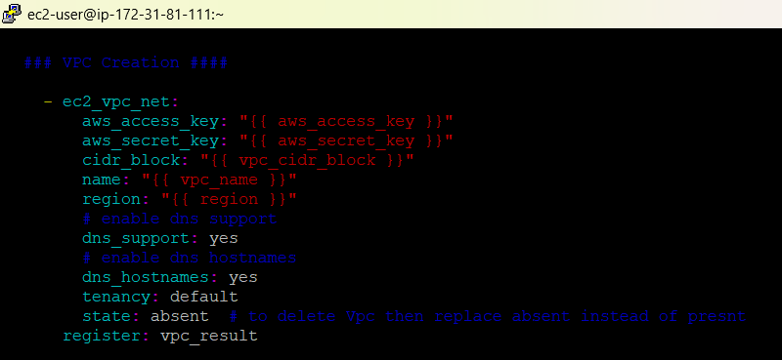

Slide 8
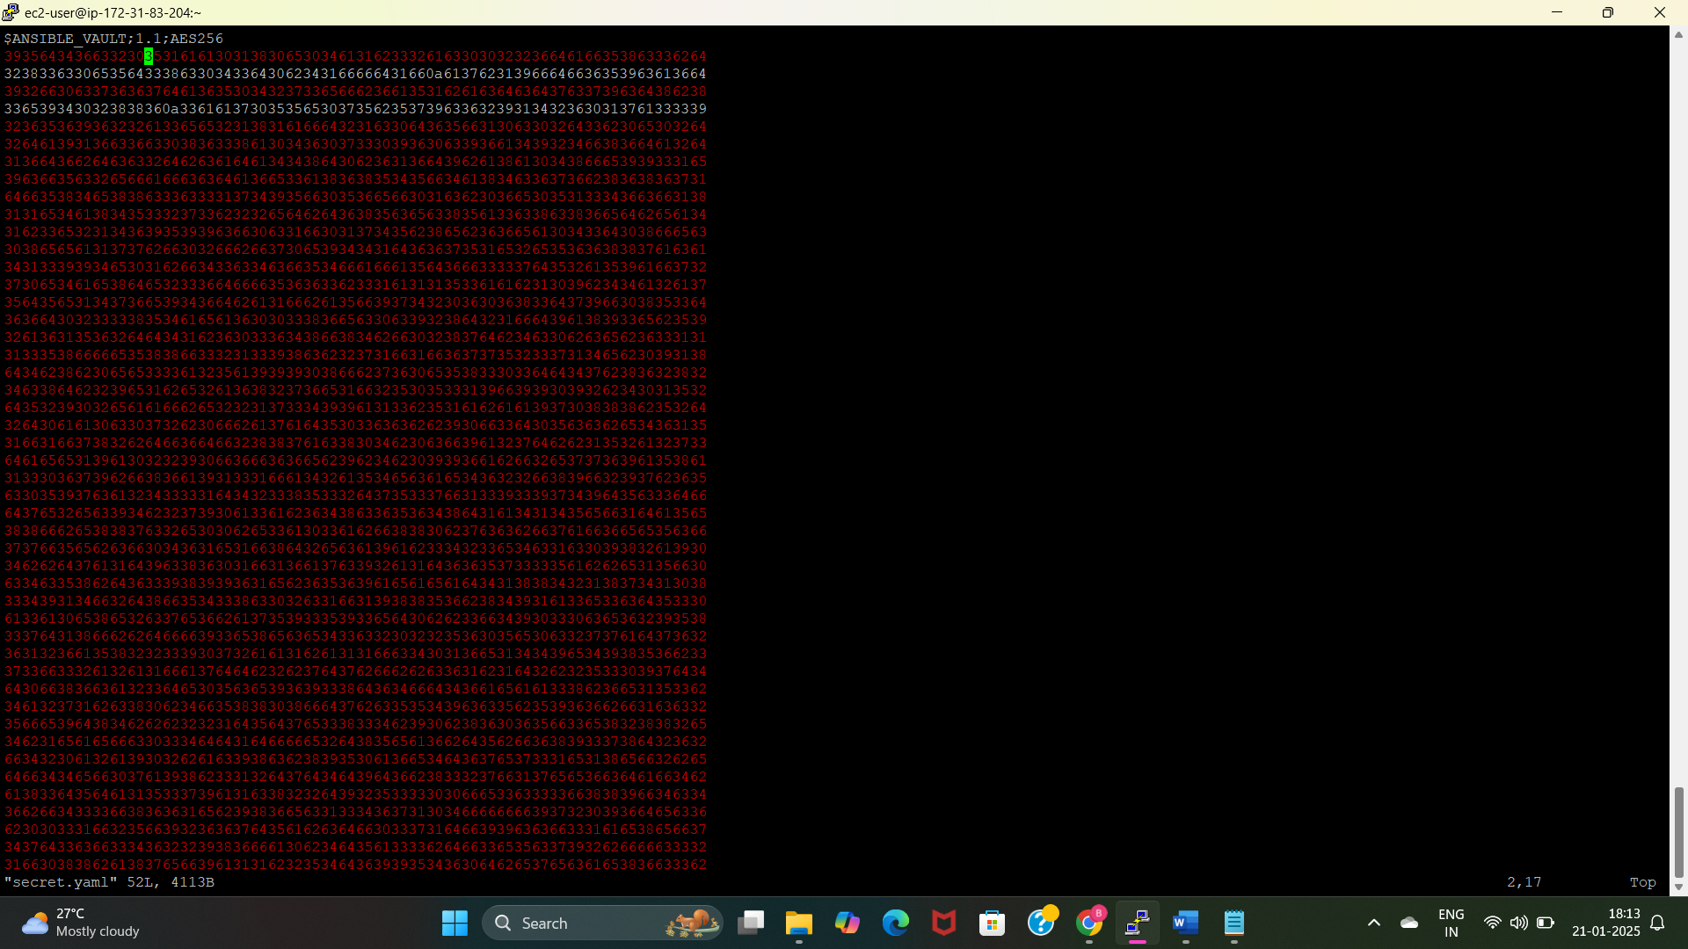
Outline Variables
It refers to variables defined outside the task or play in more structured ways, such as in variable files, inventory files, or group/host variables.
These variables are stored in external files or specific locations in the Ansible project structure for reusability, modularity, and organization.
Playbook name: outline.yml.
Variable file name: secrets.yml.
Encrypt the secret key using “ansible-vault encrypt secrets.yml”.
Command to run the playbook “ansible-playbook outline.yml –ask-vault-pass”.

Slide 9
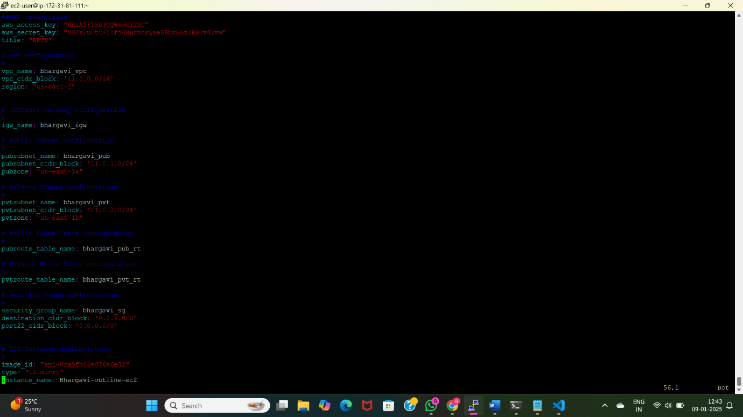
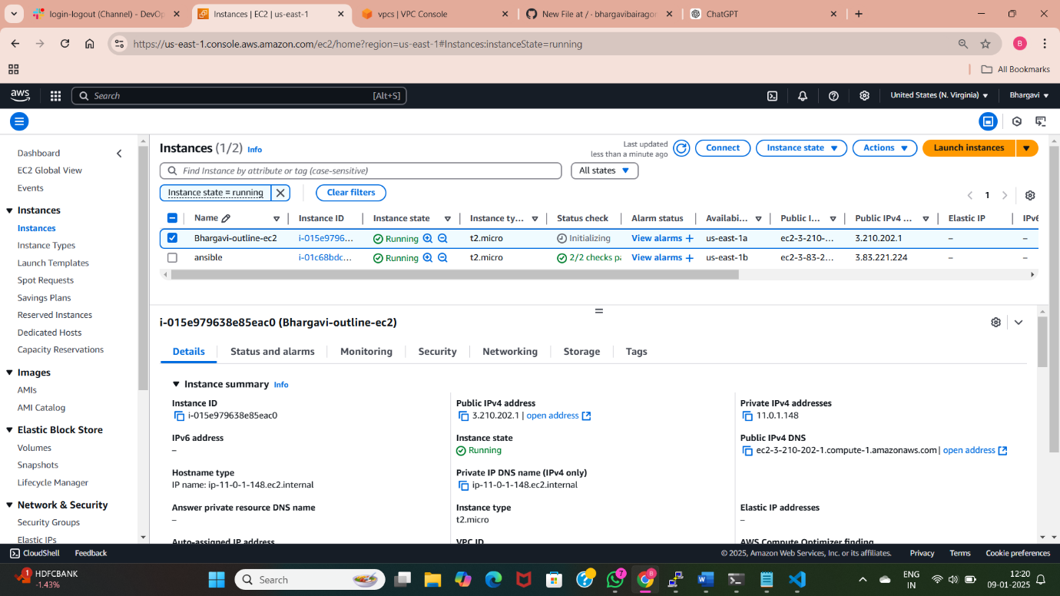
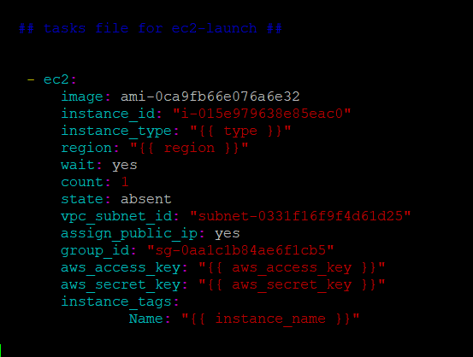

Slide 10
Without Variables
An Ansible Playbook without variables is a straightforward script where all values and configurations are hardcoded within the tasks. It is used for static, simple automation tasks with no need for external input, dynamic customization, or reusability.
Playbook name: without.yml
Command to run the playbook and create the resources are “sudo ansible-playbook without.yml”.

Slide 11
